Slide 1
Banking Application
PROJECT
Presented By:
Kote Ashwini

Slide 2
INTRODUCTION
In this section, we will learn how to create a mini-application for a banking system in Java. In this program, we will add some basic functionalities of a bank account like a deposit of amount, withdrawal of amount, etc.
Initially, the program accepts the number of customers we need to add and adds the customer and account details accordingly. Further, it displays the series of menus to operate over the accounts.

Slide 3
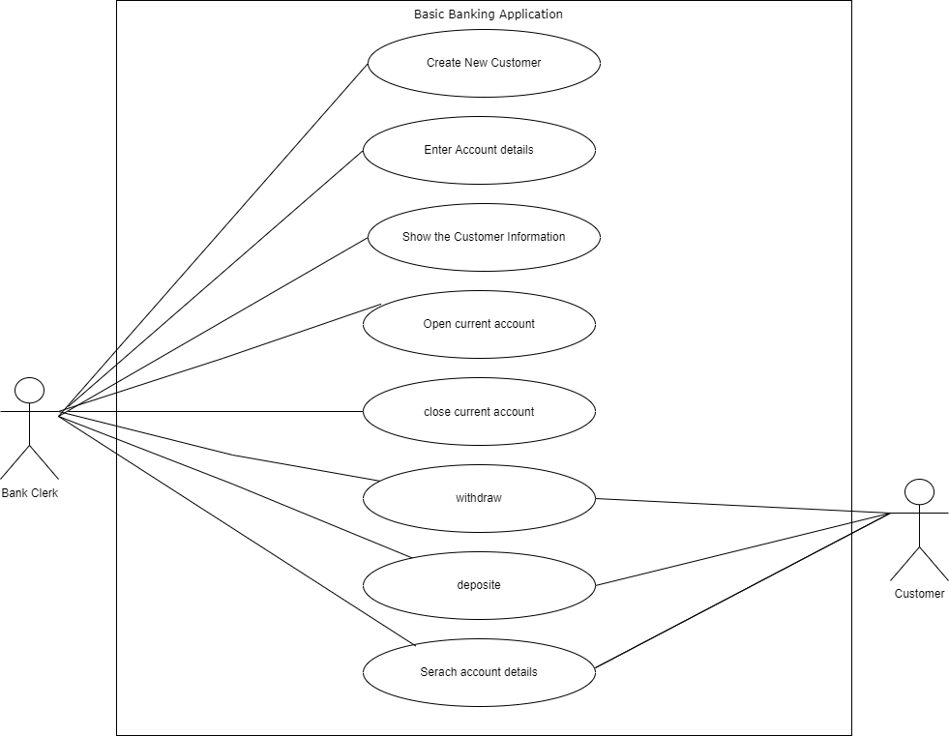
Use Case Diagram

Slide 4
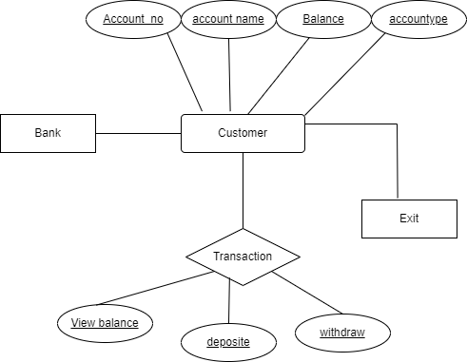
ER-Diagram

Slide 5
Module Implementation
Customer Login:
In this Project first user enter the How many number of customers do you want to input. Enter the details of customer.
Banking System Application:
Initially, the program accepts the number of customers we need to add and adds the customer and account details accordingly. Further, it displays the series of menus to operate over the accounts.
The series of menus displayed are as follows:
Display all account details
Search by account number
Deposit the amount
Withdraw the amount
Exit

Slide 6
Future Scope
Creating New Accounts- The application can be used to create two different types of accounts by the customers, which are Savings Account and Current Account. It helps save the hustle for the customer to visit the bank physically and create/use these accounts.
Depositing Money- As the world is moving towards the limited use of paper currency, depositing or transferring money from one bank to the other will become as easy as clicking a few buttons using this application.
Withdrawing Money- Requests can be sent through the application to ask for money transfer as well.
Account Holder List- This is a feature for the admin. The admin can view the list of all the account holders.
Balance Enquiry- The customer can check their balance via this application.
Changing Passwords/PIN- The customer can easily change the passwords and pin numbers using the application.
Closing- The customer can close their accounts too using this application.

Slide 7
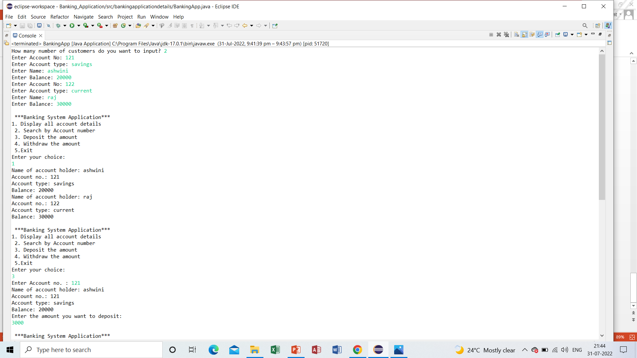
Output

Slide 8
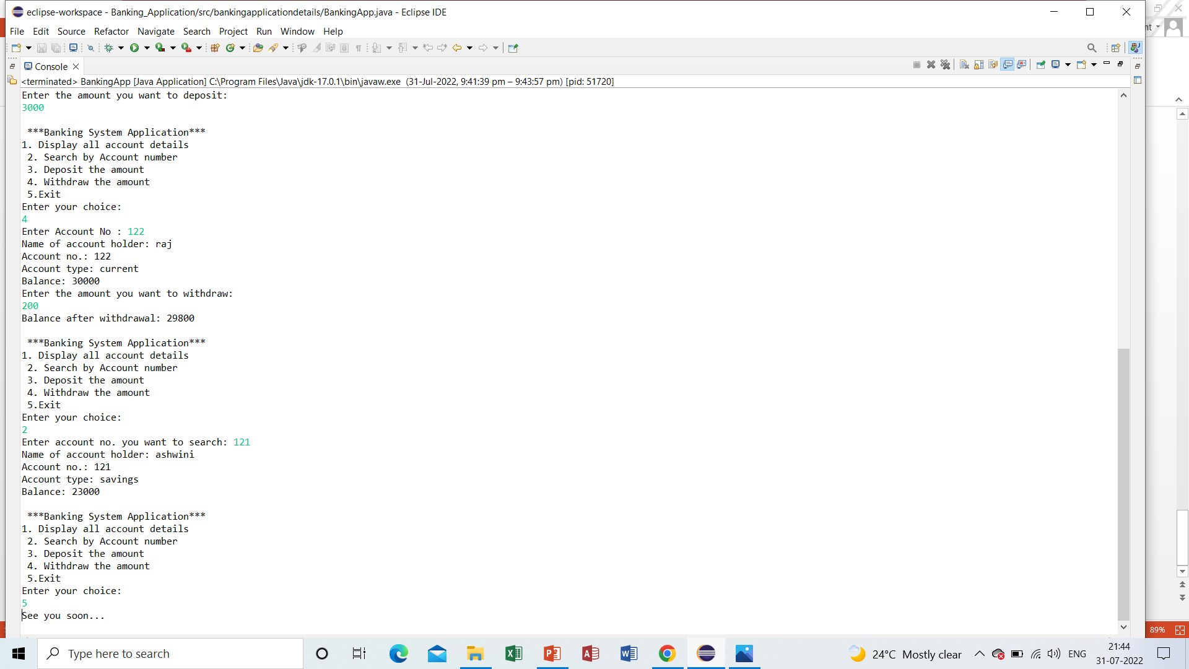

Slide 9
Conclusion
In this presentation one can observe that an Bank Application is associated with transaction of the customers.
A bank account is not only about saving money, it's also about managing money. Opening an account is a smart move - it means that you can access a service that helps you control your money, and which may help you borrow at some time in the future, if you need to do so.
Also we can Deposite money in to the bank and search the particular person account that we want to search.

Slide 10
References
http://www.google.com
http://www.youtube.com

